Slide 1
Employability Evaluator Model For Loan Eligibility

Slide 2
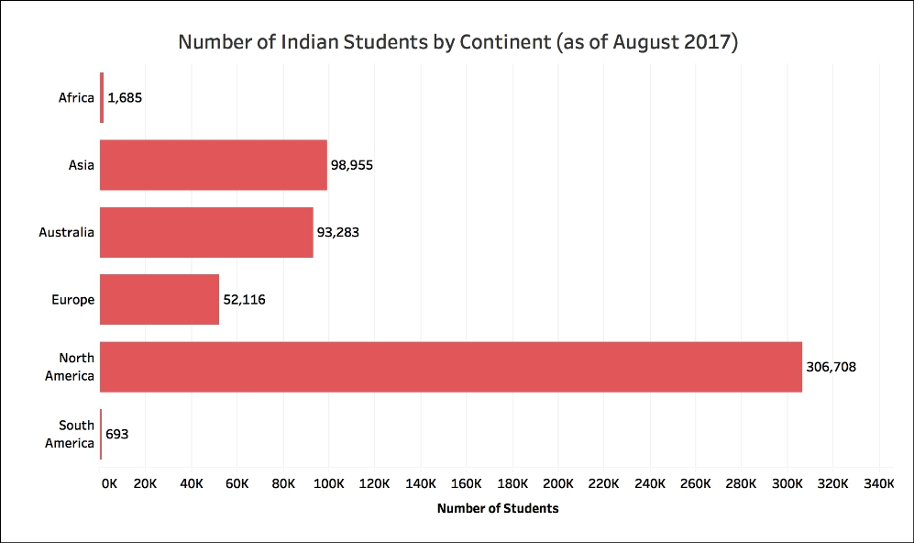
DISTRIBUTION – Indian students
Source - factly.in

Slide 3
SUMMARY
Spending on tuition and hostel fees by Indian students studying abroad has shot up 44% from $1.9 billion in 2013-14 to $2.8 billion in 2017-18 : RBI
Count of Indian students studying in the US went up from 132,888 in 2014-15 to 186,267 in 2016-17.
Around 3 lakh Indian students go abroad annually for pursuing Masters.
Nearly 33% take property-backed loans.
Estimated 5.53 lakh Indian students studying in 86 different countries
An average increase of 7 to 10% (conservative estimate) in number of students going abroad every year.
Majority students reject the offers because of the lack of any tangible collateral.

Slide 4
PREDICTED JOB TRENDS :
Data Science jobs have grown at over 650% since 2012.
Machine Learning jobs grew at a rapid rate of 9.8x in the last 5 years.
Jobs for Database Engineer/Architect, Business Intelligence Analyst, Data Analyst and similar domains are all time high.

Slide 5
STUDENT’S PERSPECTIVE
Banks in India don’t do higher educational loans.
NBFC’S rely on banks for loan processing.
NBFC’s generate negative sentiments (charging processing fee).
Students dependency on third party to convince banks.
Lack of data science perspective for evaluation.
Student rejects admit offers in most of the cases.

Slide 6
PROBLEM STATEMENT
Lot number of student’s fail to secure loans for higher education, every year.
Student may have decent profile and skills to land up a job after their masters.
Many of them don’t have any tangible collateral security.
Finally banks refuse to process their loan.
Bank judges only student’s financial standards strictly.
Traditional banking convention followed for higher education loans.
No proper Data Science Model perspective leveraged for solution.

Slide 7
SOLUTION – A DATA SCIENCE MODEL
Developing a Data Science classification model.
Model that evaluates a student’s profile, skills academic background.
2 STAGED PROCESS :
STAGE 1 : Data Science Model Evaluation.
STAGE 2 : Evaluating secondary parameters like
Collateral/Property.
Family Background details etc. as appropriate by the banking team.

Slide 8
classification MODEL APPROACH
Target Identification for data (linkedin.com).
Large scale data harvesting.
Indian students pursuing/completed Masters in ‘STEM’.
Extensive Data Wrangling, Structuring and Parameter evaluation.
Data Labelling.
Splitting the data into 75% training set and 25% testing set.
Developing a supervised learning classification model.

Slide 9
INPUT/INDEPENDENT FEATURES
Undergrad CGPA
Undergrad college Tier
No of research papers published
Number of internships during undergrad
Whether Job after Under graduation
Job Experience in years after under graduation
World ranking of university(Masters)
TO PREDICT/DEPENDENT FEATURE
Whether got job within 1 year of MS completion or not

Slide 10
Cases Included
Student Getting a job within 1 year of Masters Completion labelled as 1 else 0.
Following cases not considered as proper jobs (after Masters) :
Teaching Assistant in the University.
Research Assistant in the University.
Graduate Research Assistant in the University.
Developer jobs performed within the University.
University Research Intern.
Intern position in any company if pursued for more than 4 months.

Slide 11
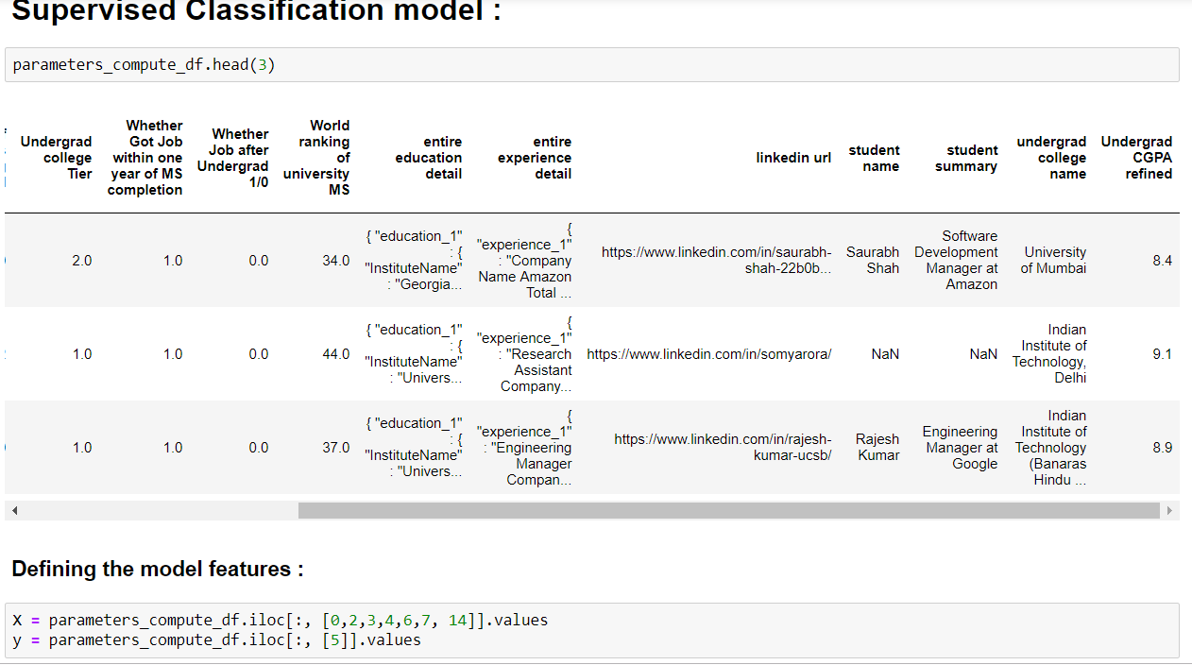
SAMPLE SCREENSHOT

Slide 12
BEST MODEL FOR OPTIMIZATION :
LOGISTLOGISTIC REGRESSION MODEL
DECISION TREE CLASSIFIER
ENSEMBLING
STACKED CLASSIFIER

Slide 13
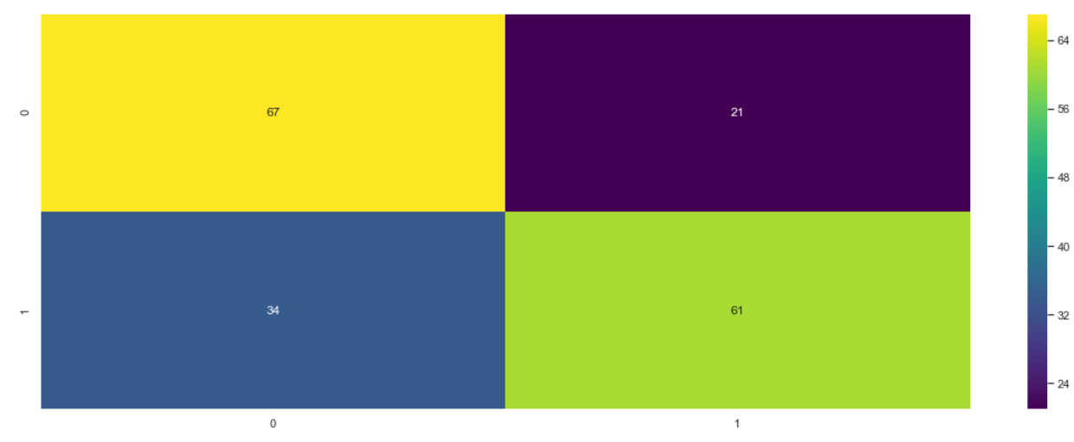
CONFUSION MATRIX 1 – Job after Masters (within an year of completion) 0 – No Job after Masters (within an year of completion)
0 - TRUE
1 - TRUE
0 – MODEL 1 - TRUE

Slide 14
Interpreting the model performance
Evaluating the model on the test set of 117 students.
Model - 1, Reality - 1 : 61 students
Model - 1, Reality - 0 : 34 students
Model - 0, Reality - 1 : 21 students
Model - 0, Reality - 0 : 67 students
Model – 0 : Student will not get a job after masters (within 1 year)
Model – 1 : Student will get a job after masters (within 1 year)
Reality – 1 : Student got a job after masters successfully (within 1 year)
Reality – 0 : Student didn’t get a job after masters (within 1 year)

Slide 15
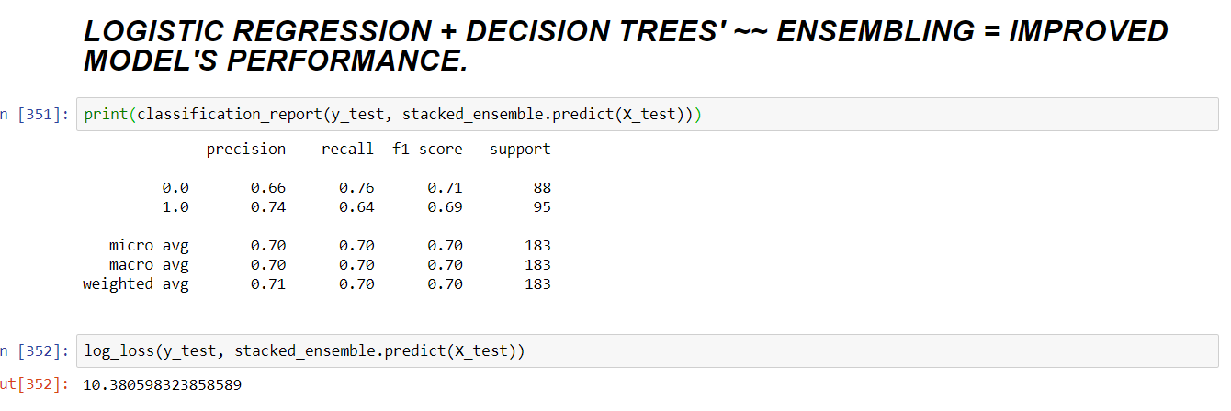
MODEL PERFORMANCE

Slide 16
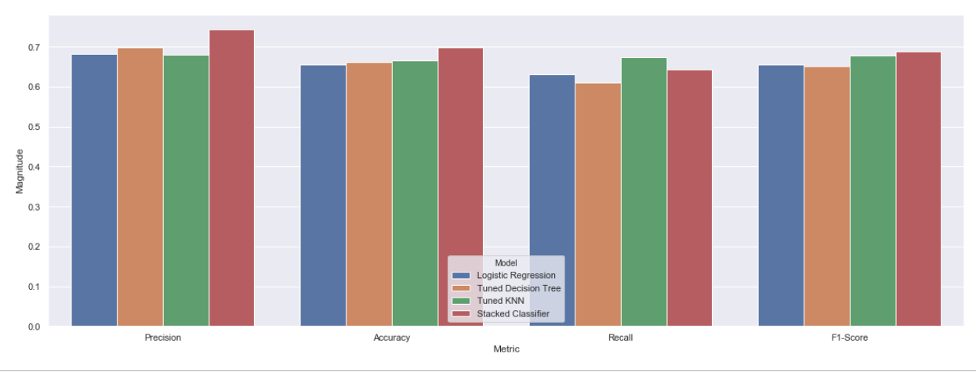
Initial performance on test data

Slide 17
Important conclusions
A RISKY CASE :
Providing loan to a non deserving students.
Model achieves proven recall score of 80% (80% success of mitigating the above mentioned risk).
NON RISKY/SAFE CASES :
Not Providing loan to a deserving student.
Not providing loan to a non deserving student.
Providing loan to a deserving student

Slide 18
MODEL IMPROVEMENT
Focus on 2 input features :
Job Experience in years after undergrad.
Number of internships during undergrad.
REPLACEMENT :
‘Job Experience in years after Undergrad’ with ‘job score’ factor.
‘Number of internships during undergrad’ with ‘internship score’.

Slide 19
HOW THIS MODEL HELPS THE BANK
Student need not go to any third party to convince bank for loan solutions.
Profile evaluation and banking assessment on the go.
Leveraging the power of Data Science to generate revenues.
Mitigates the participation of any third party/NBFC(s).
Common platform for the bank and the student.

Slide 20
Thank You

